Slide 1
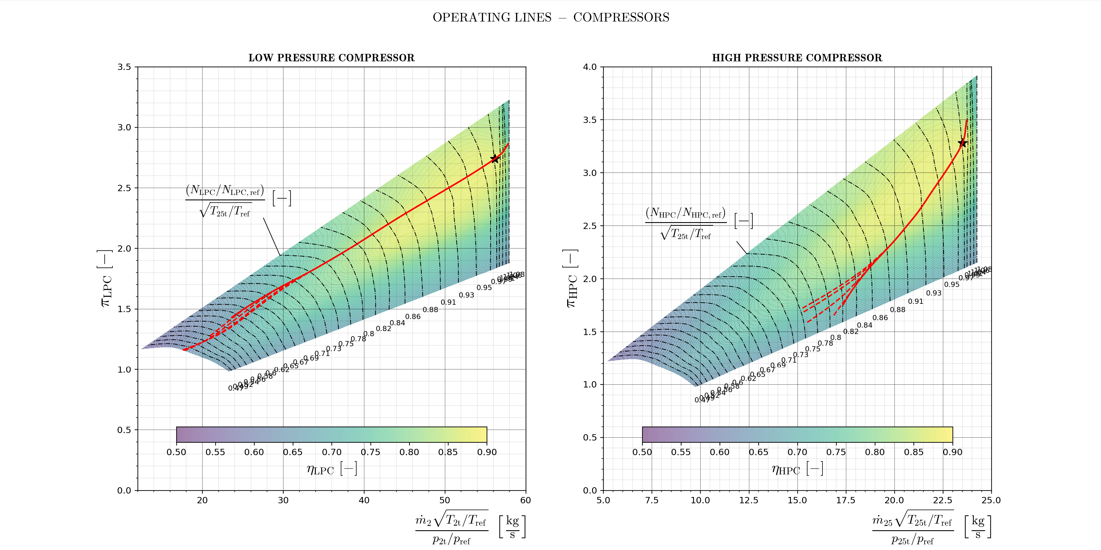
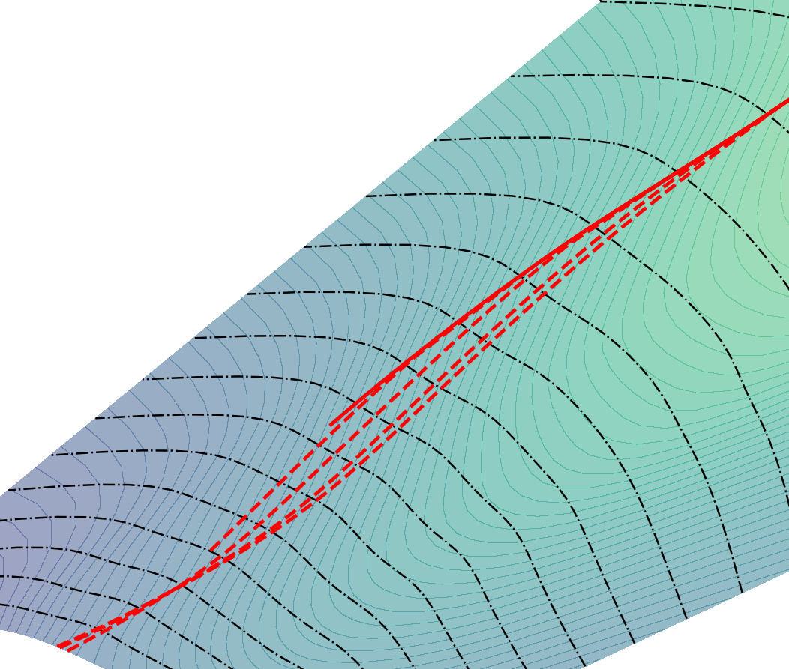
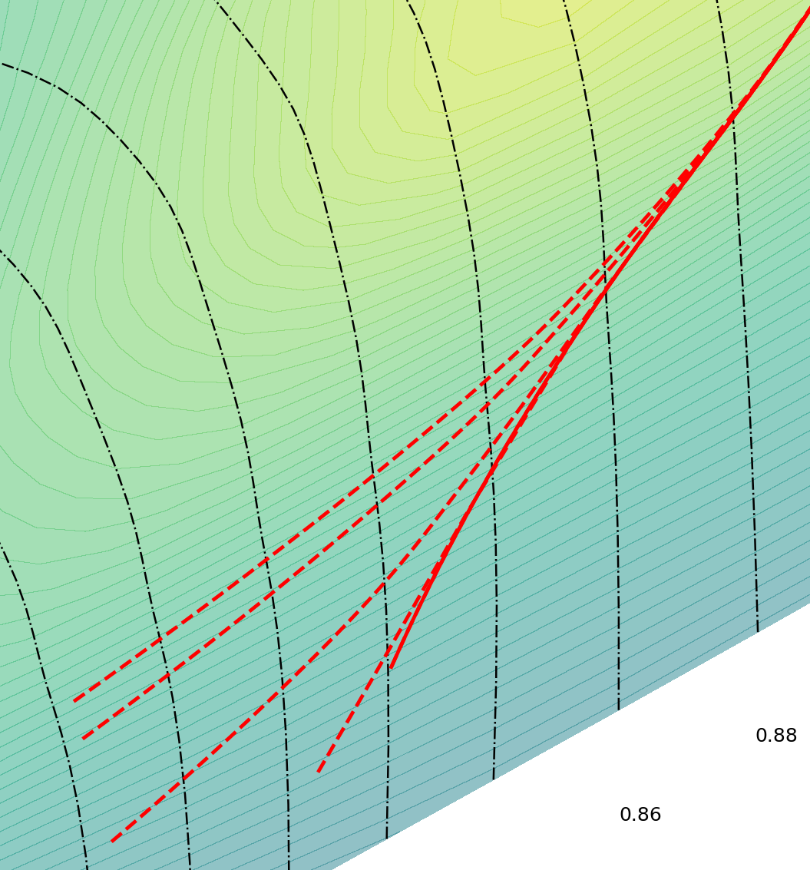




CHOKED NOZZLE SUBSONIC NOZZLE
M₀ $[−]$
M₀ $[−]$
$$\frac{\left(N_{LPC}/N_{LPC,ref}\right)}{\sqrt{T_{2t}/T_{ref}}} [−]$$
1.0
0.75
0.0
0.0
0.5
1.0
0.25
0.25
0.75
0.5
$$\frac{{(N}_{HPC}/N_{HPC,ref})}{\sqrt{T_{25t}/T_{ref}}} [−]$$

Slide 2
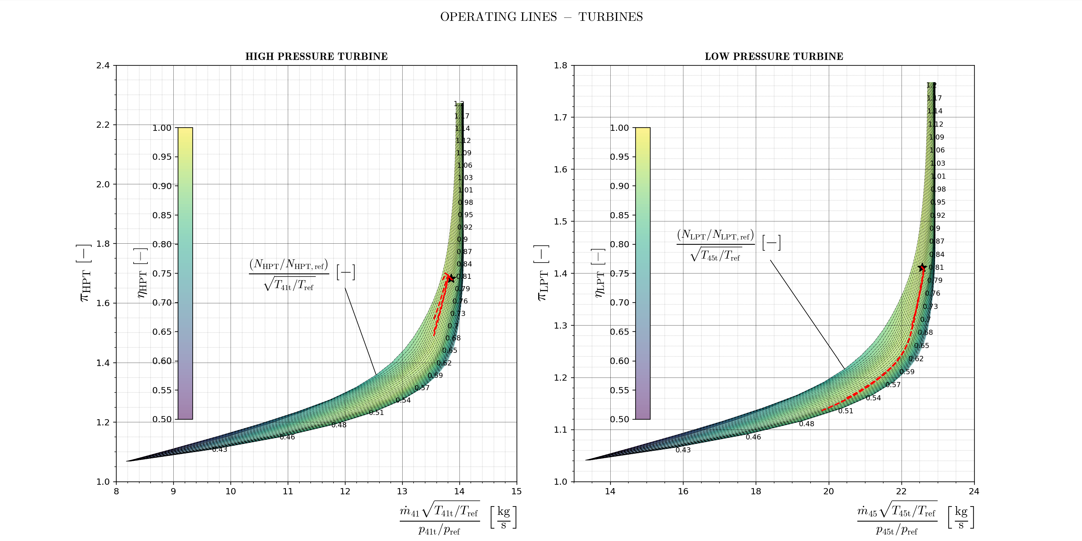
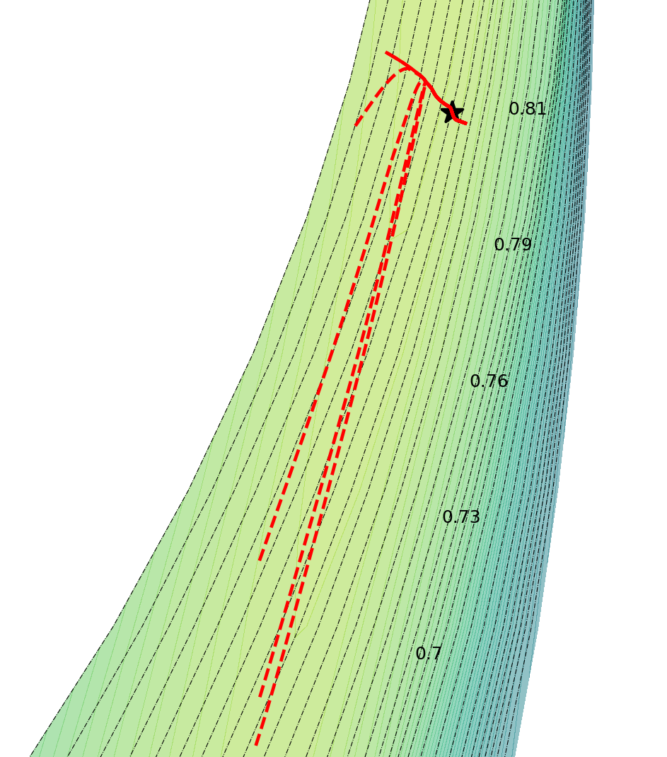
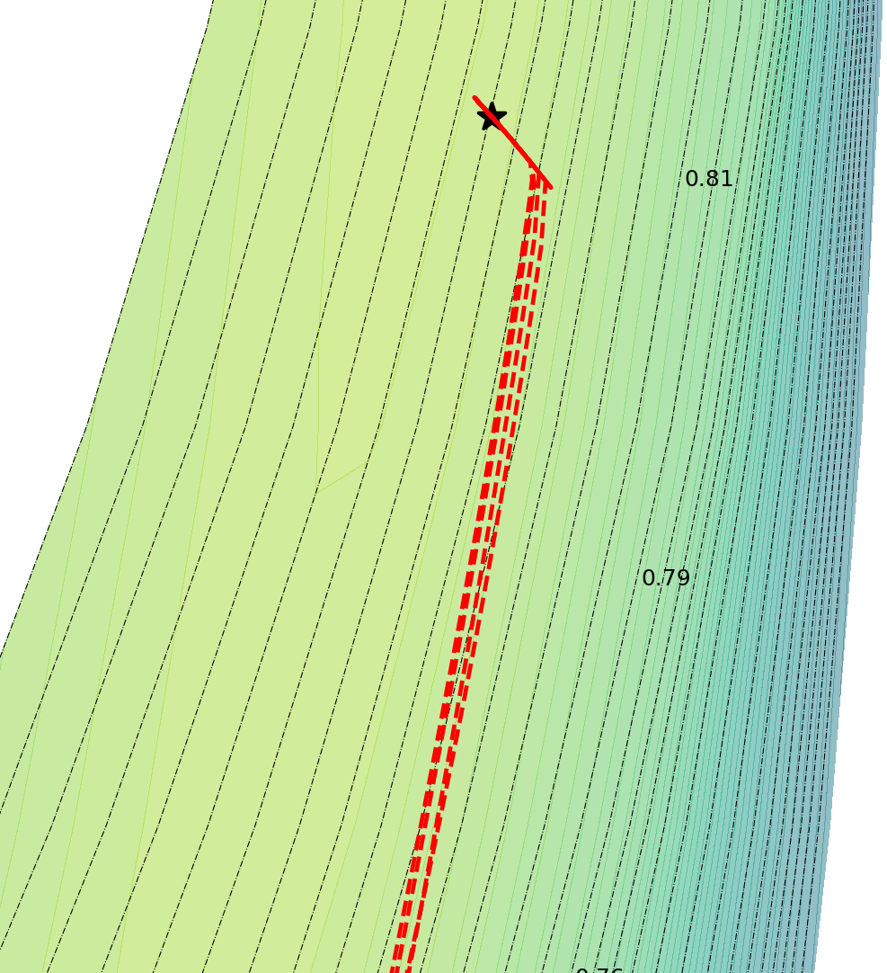




CHOKED NOZZLE SUBSONIC NOZZLE
M₀ $[−]$
1.0
M₀$[−]$
0.75
0.25
0.5
1.0
0.5
0.25
0.0
0.0
0.75
$$\frac{\left(N_{HPT}/N_{HPT,ref}\right)}{\sqrt{T_{41t}/T_{ref}}} [−]$$
$$\frac{{(N}_{LPT}/N_{LPT,ref})}{\sqrt{T_{45t}/T_{ref}}} [−]$$

